Slide 1
Reinforcement Learning to Enhance Spatial Reuse in Dense Wireless Networks
a Thesis Proposal

Slide 2
Outline
Motivation
Spatial Reuse in Wireless Networks
Current SR Solutions for IEEE 802.11 WLANs
Reinforcement Learning for enhancing SR
Contributions & Future Work

Slide 3
Motivation

Slide 4
Main Research Activity
Improve performance and efficiency of Wireless Networks
What?
In which context?
IEEE 802.11 WLANs, more specifically in High-Efficiency (HE) WLANs – IEEE 802.11ax
With which tools?
Artificial Intelligence (AI),
more precisely Reinforcement Learning (RL)

Slide 5
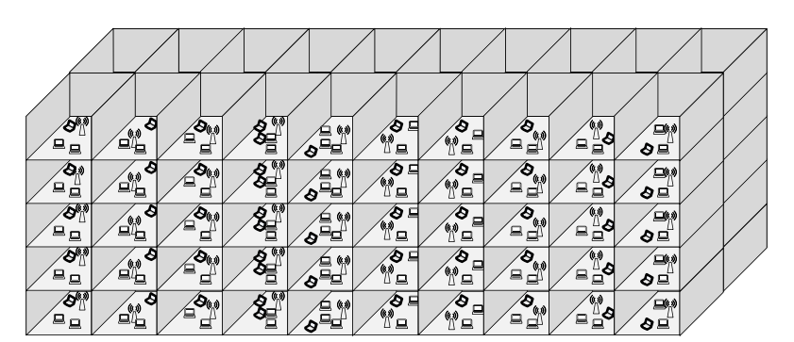
Next-generation IEEE 802.11 WLANs
Network Architectures
Scenarios in IEEE 802.11ax
Future WLAN deployments will be characterised by the high amount of devices that will coexist (e.g. 1 user/m²). The TGax provides a set of dense scenarios.
Residential
Enterprise
Indoor small BSS
Outdoor large BSS
Residential + Outdoor large BSS
Coordinated
Uncoordinated
Mixed
Image retrieved from [19]

Slide 6
Coexistence Issues in IEEE WLANs
Root Causes
Mainly produced by coexistence between devices operating at the same frequency band. Several mechanisms are provided in Time, Frequency and Space domains.
Potential Solutions
Time
Scheduling
Contention Window (CW) adaptation
Dense & chaotic scenarios
Weaknesses in the current distributed mechanisms
High bandwidth requirements
…
Frequency
Dynamic Spectrum Access (DSA)
Dynamic Channel Bonding (DCB)
Space
Space
Transmission Power Control (TPC)
Carrier Sense Threshold (CST) adjustment
Directional transmissions
Interference cancellation

Slide 7
Moving towards Artificial Intelligence
Challenges in SR
Solution’s Shape
Previous Work
AI may satisfy the high-demanding requirements in next-generation scenarios. There is an upward trend in combining AI with Wireless Communications.
Wireless channels are dynamic
Wireless channels are shared
Strict QoS in many apps
Observations-based learning process
Optimal solution or an approximation
Sensitive to modifications
Q-learning
Packet routing [1]
Energy harvesting [2]
MABs
Rate sampling [3]
ANNs
AP selection [4, 5]

Slide 8
Spatial Reuse in Wireless Networks

Slide 9
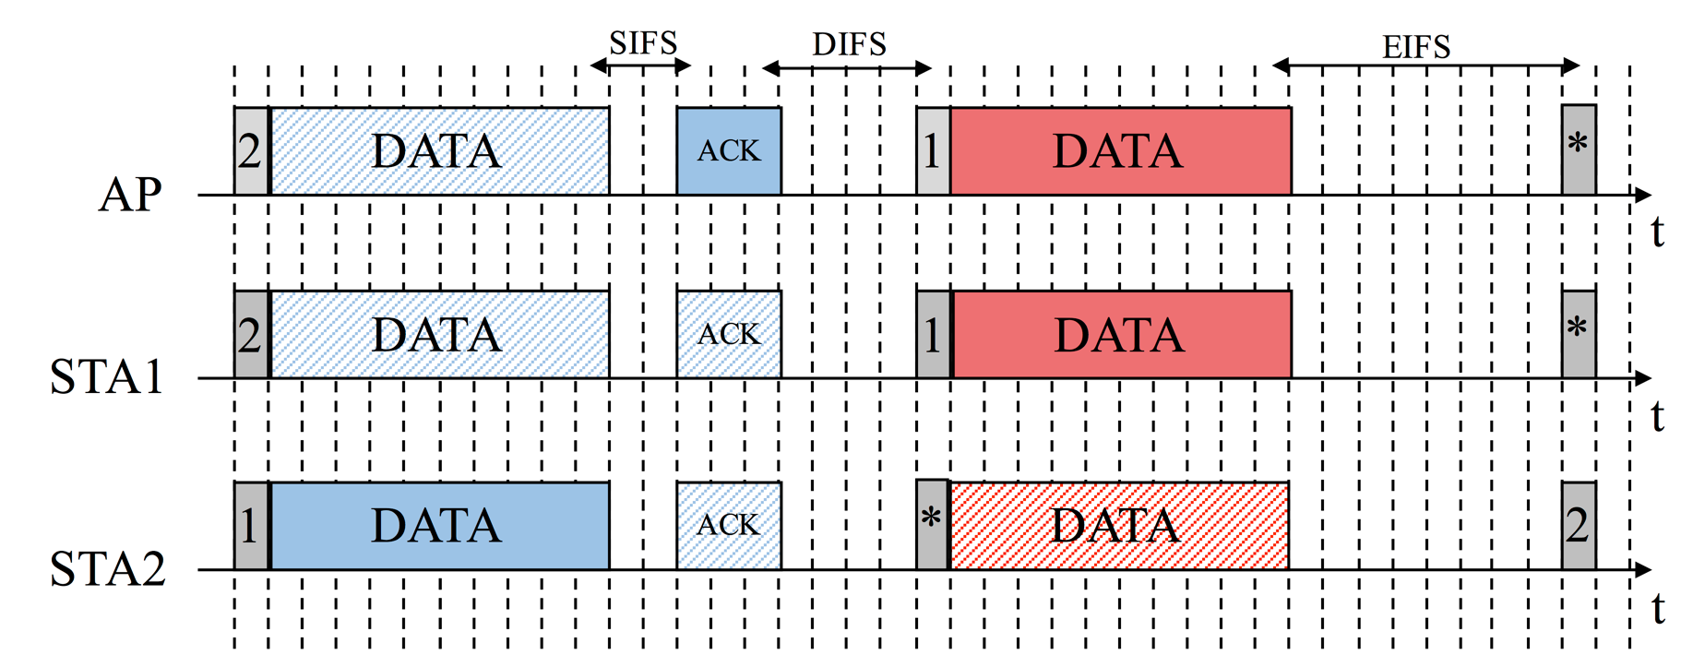
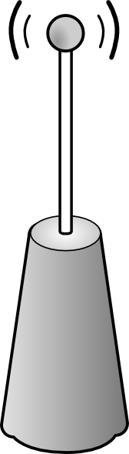
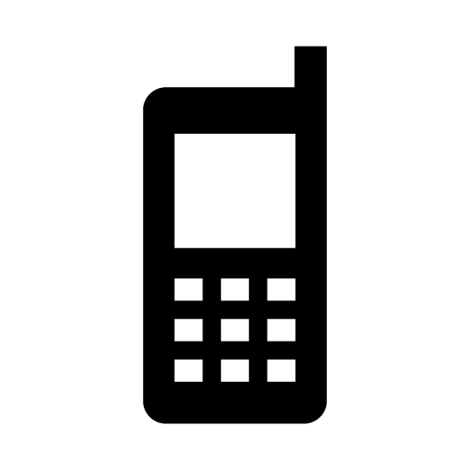
DCF in IEEE 802.11 WLANs
The Distributed Coordination Function (DCF) orchestrates the channel access for IEEE 802.11 devices in a decentralised way. It uses CSMA/CA and BEB.
STA1 listens to STA2
AP
STA 1
STA 2
Data range
Carrier sense range
*Conditioned to a fixed CST

Slide 10


DCF in IEEE 802.11 WLANs
CSMA/CA is not optimal in dense environment. Leads to coexistence issues such as Hidden or Exposed terminal problems. The overall throughput is compromised.
AP 1
Hidden Terminal Problem
Exposed Terminal Problem
STA 1
Exposed Terminal Problem
Transmitters do not sense each other
Receivers are affected by interferring nodes
The collisions probability increases
Transmitters sense each other
Receivers are not affected by interferring nodes
The number of parallel transmissions decreases
AP 2
STA 2
Hidden Terminal Problem
STA 3
Data range
AP 3
Carrier sense range
*Conditioned to a fixed tx power / CST

Slide 11
Spatial Reuse
Spatial reuse aims to increase the capacity in an area in which several devices share the medium.
TPC
CST adjustment
Directional transmissions
Interference cancellation
Decrease the transmission area
Increase the number of parallel transmissions
Increase the transmission area
Allow farther transmissions
Reduce the carrier sense area
Increase the number of parallel transmissions
Increase the carrier sense area
Allow farther transmissions
Reduce the interference area
Increase the number of parallel transmissions
Increase the number of parallel transmissions
PHY overhead of training sequences
STA 1
Antenna 3
AP 1
Antenna 4
STA 1
Antenna 1
STA 2
AP 1
AP 1
STA 1
AP 1
AP 1
Antenna 2
STA 1
AP 1
STA 1
Antennas 1 and 2 transmit simultaneously to antennas 3 and 4, respectively.
AP 2
AP 2
STA 1
Initial tx power
Increased CST to avoid AP2’s interference
Initial CST in which collisions occur
Omnidirectional transmission
Directional transmission
Reduced tx power

Slide 12
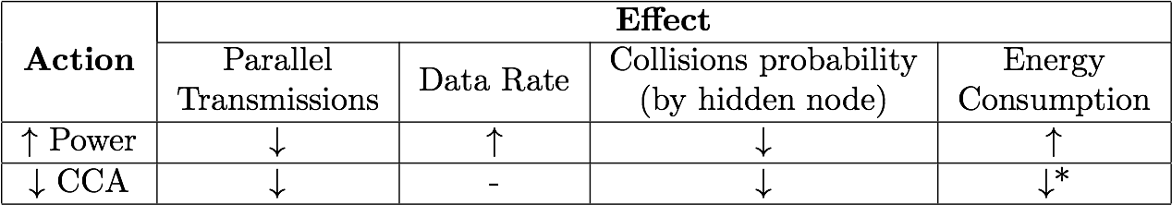
Effects on TPC and CST Adjustment
Adjusting either the power or the sensitivity has direct effects on the performance of a WLAN, specially in high-density scenarios.
*Adjusting CCA may indirectly affect to the energy consumption by requiring more/less power to be transmitted.
Several trade-offs
Complex solution
Need of learning the solution, not computing it
Notes:
Enfasis en trade-offs I com trobar punt optim

Slide 13
Current SR Solutions for IEEE 802.11 WLANs

Slide 14
Previous Work in TPC & CST Adjustment
Power Adaptation
CST adjustment
Energy saving
DSC [18, 19, 20]
Throughput enhancement
Communication based
Local information based
Based on the RTS/CTS mechanism [7, 8, 9, 10, 11]
Based on IEEE 802.11k [21, 22]
Beaconing modification [23]
Multiple AP [24, 25]
Based on the Packet Error Rate (PER) [26]
Based on experienced collisions [27]
Based on the RTS/CTS mechanism [12]
Channel measurements [13, 14]
Channel characteristics inference [15]
Clustering-based [16, 17]
Proposed for the IEEE 802.11ax amendment
Notes:
Reenfocar SoA

Slide 15
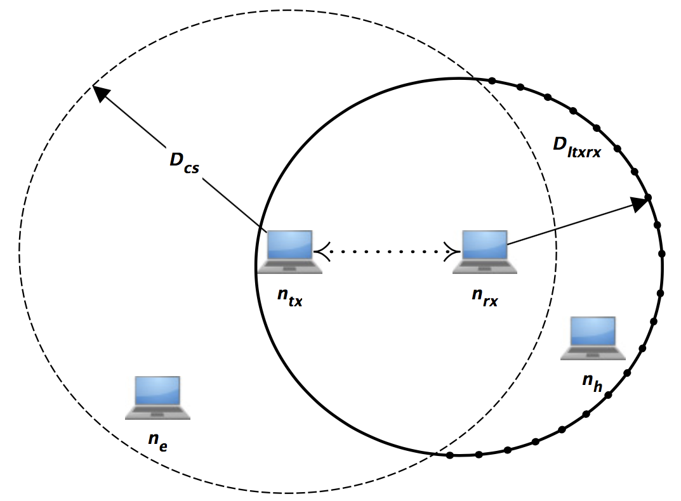
Transmit Power and CST Relationship
Naive principle: “to shout, you need to listen more carefully”
The necessary transmit power can be computed according to the CCA
Previous work [28, 29, 30]
The maximum transmit power in a STA is constrained by the Power Detection (PD) level:
IEEE 802.11ax

Slide 16
Reinforcement Learning for enhancing SR

Slide 17

WNs strongly interact with the environment
High variability
Training a system may be infeasible and not practical

Slide 18
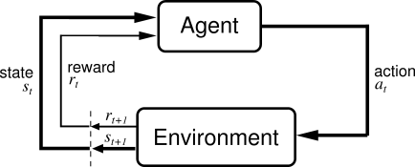
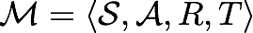
Reinforcement Learning
An agent attempts to learn a policy given the observations it does. The goal is to maximise the expected future cumulative reward.
S: set of states
A: set of actions
R_{a,s}: reward
T(s,a,s’): transition probability
MDP formulation:
No supervisor (only reward signal)
Delayed feedback & sequentiality
Actions affect the environment
Examples:
Q-learning, SARSA, TD-learning

Slide 19
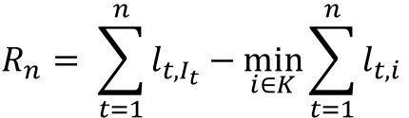
The Multi-Armed Bandits Problem
Frames the exploration/exploitation trade-off. The hidden reward distributions must be learnt while maximising the gains.
Action-selection strategies to cope with hidden distributions (𝜺-greedy, EXP3, UCB…)
Several variants (contextual, adversarial, stochastic, restless…)
States-independent
Reward becomes regret
$$R_{n}= \sum_{t=1}^{n}{l_{t,I_{t}}−\min_{i∈K}{\sum_{t=1}^{n}{l_{t,i }}}}$$
Image retrieved from [31]

Slide 20
RL in WNs – Previous Work
There are few papers applying RL to WNs. In addition, RL is “heuristically” applied for very concrete scenarios (in general).
Real-time Q-learning for DCA [32]
Q-learning for channel selection in mobile communications [33, 34]
MABs for channel selection in D2D communications [35]
MABs for channel allocation and TPC in D2D communications [36]
ANN for adjusting CST and transmit power [37]

Slide 21
Decentralised Q-learning
Index | Channel | TX Power (dBm)
1 | 1 | 5
2 | 2 | 5
3 | 1 | 10
4 | 2 | 10
5 | 1 | 15
6 | 2 | 15
7 | 1 | 20
8 | 2 | 20
Work in [38]
Adversarial & uncoordinated scenario
Agents use only local information
Stateless Q-learning to tune the transmit power and the frequency channel
Notes:
Moure a RL

Slide 22
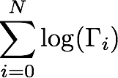
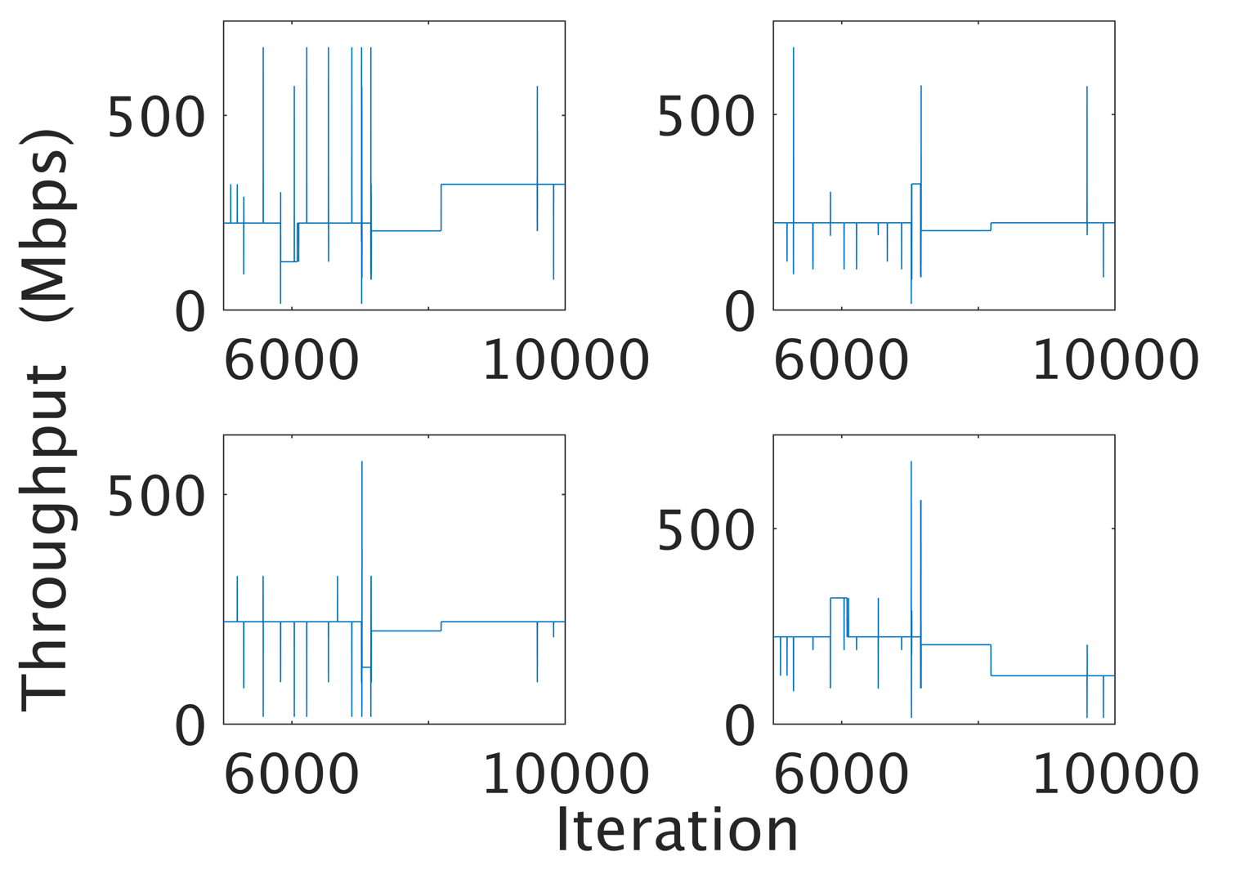
Coordinated Approach
The reward is shared
Set to the proportional fairness:
↓ Variability
↓ Fairness

Slide 23
Contributions & Future Work

Slide 24
Research Activity
Expected Contributions
Expected Outputs
A survey on spatial reuse in WNs
Komondor’s versions 2.1 and 2.2 & Technical report
Publication resulting from CTMN framework collaboration
1
Understand challenges & limitations in future WLANs
1
2
Study the practicality of using RL to enhance SR in WNs
2
A survey on RL applied to Wireless Communications
Publication of practical application of RL in WNs
Design decentralised ML-based solutions for enhancing SR
Integrate these solutions with others, such as DCB
3
Publication applying CTMN to decentralised learning
Publication of actions inference by WNs
Publication of coordinated approaches in WNs
3
5
Provide centralised ML-based solutions for enhancing SR
4
4
Publication of centralised learning approaches in WNs
5
Publication of SR and DCB application in WNs
Notes:
Enfasis en inferència

Slide 25
Reinforcement Learning to Enhance Spatial Reuse in Dense Wireless Networks

Slide 26
References (I)
[1] Littman, M., & Boyan, J. (1993, July). A distributed reinforcement learning scheme for network routing. In Proceedings of the international workshop on applications of neural networks to telecommunications (pp. 45-51). Psychology Press.
[2] Miozzo, M., Giupponi, L., Rossi, M., & Dini, P. (2015, June). Distributed Q-learning for energy harvesting Heterogeneous Networks. In Communication Workshop (ICCW), 2015 IEEE International Conference on (pp. 2006-2011). IEEE.
[3] Combes, R., Proutiere, A., Yun, D., Ok, J., & Yi, Y. (2014, April). Optimal rate sampling in 802.11 systems. In INFOCOM, 2014 Proceedings IEEE (pp. 2760-2767). IEEE.
[4] Bojovic, B., Baldo, N., Nin-Guerrero, J., & Dini, P. (2011, December). A supervised learning approach to cognitive access point selection. In GLOBECOM Workshops (GC Wkshps), 2011 IEEE (pp. 1100-1105). IEEE.
[5] Bojovic, B., Baldo, N., & Dini, P. (2012, January). A neural network based cognitive engine for IEEE 802.11 WLAN access point selection. In Consumer Communications and Networking Conference (CCNC), 2012 IEEE (pp. 864-868). IEEE.
[6] Sobrinho, J. L., De Haan, R., & Brazio, J. M. (2005, March). Why RTS-CTS is not your ideal wireless LAN multiple access protocol. In Wireless Communications and Networking Conference, 2005 IEEE (Vol. 1, pp. 81-87). IEEE.
[7] Agarwal, S., Katz, R. H., Krishnamurthy, S. V., & Dao, S. K. (2001, September). Distributed power control in ad-hoc wireless networks. In Personal, Indoor and Mobile Radio Communications, 2001 12th IEEE International Symposium on(Vol. 2, pp. F-F). IEEE.
[8] Karn, P. (1990, September). MACA-a new channel access method for packet radio. In ARRL/CRRL Amateur radio 9th computer networking conference (Vol. 140, pp. 134-140).
[9] Ebert, J. P., & Wolisz, A. (2001). Combined tuning of RF power and medium access control for WLANs. Mobile Networks and Applications, 6(5), 417-426.
[10] Pursley, M. B., Russell, H. B., & Wysocarski, J. S. (2000). Energy-efficient transmission and routing protocols for wireless multiple-hop networks and spread-spectrum radios. In EUROCOMM 2000. Information Systems for Enhanced Public Safety and Security. IEEE/AFCEA (pp. 1-5). IEEE.
[11] Jung, E. S., & Vaidya, N. H. (2002, September). A power control MAC protocol for ad hoc networks. In Proceedings of the 8th annual international conference on Mobile computing and networking (pp. 36-47). ACM.
[12] Lei, X., & Rhee, S. H. (2015). Performance enhancement of overlapping BSSs via dynamic transmit power control. EURASIP Journal on Wireless Communications and Networking, 2015(1), 8.
[13] Chaves, F. S., Cavalcante, A. M., Almeida, E. P., Abinader, F. M., Vieira, R. D., Choudhury, S., & Doppler, K. (2014, September). Adaptive transmit power for Wi-Fi dense deployments. In Vehicular Technology Conference (VTC Fall), 2014 IEEE 80th (pp. 1-6). IEEE.

Slide 27
References (II)
[14] Gandarillas, C., Martín-Engeños, C., Pombo, H. L., & Marques, A. G. (2014, April). Dynamic transmit-power control for WiFi access points based on wireless link occupancy. In Wireless Communications and Networking Conference (WCNC), 2014 IEEE (pp. 1093-1098). IEEE.
[15] Oteri, O., La Sita, F., Yang, R., Ghosh, M., & Olesen, R. (2015, December). Improved Spatial Reuse for Dense 802.11 WLANs. In Globecom Workshops (GC Wkshps), 2015 IEEE (pp. 1-6). IEEE.
[16] Tang, S., Yomo, H., Hasegawa, A., Shibata, T., & Ohashi, M. (2014). Joint transmit power control and rate adaptation for wireless LANs. Wireless personal communications, 74(2), 469-486.
[17] ElBatt, T. A., Krishnamurthy, S. V., Connors, D., & Dao, S. (2000). Power management for throughput enhancement in wireless ad-hoc networks. In Communications, 2000. ICC 2000. 2000 IEEE International Conference on (Vol. 3, pp. 1506-1513). IEEE.
[18] IEEE P802.11ax/D1.0, November 2016, 191-192.
[19] Afaqui, M. S., Garcia-Villegas, E., Lopez-Aguilera, E., & Camps-Mur, D. (2016, May). Dynamic sensitivity control of access points for IEEE 802.11 ax. In Communications (ICC), 2016 IEEE International Conference on (pp. 1-7). IEEE.
[20] Afaqui, M. S., Garcia-Villegas, E., & Lopez-Aguilera, E. (2016, April). Dynamic sensitivity control algorithm leveraging adaptive RTS/CTS for IEEE 802.11 ax. In Wireless Communications and Networking Conference (WCNC), 2016 IEEE(pp. 1-6). IEEE.
[21] Thorpe, C., Murphy, S., & Murphy, L. (2009, October). IEEE802. 11k enabled adaptive physical carrier sense mechanism for wireless networks (K-APCS). In Proceedings of the 4th ACM workshop on Performance monitoring and measurement of heterogeneous wireless and wired networks (pp. 209-215). ACM.
[22] Thorpe, C., Murphy, S., & Murphy, L. (2011, May). IEEE802. 11k enabled adaptive carrier sense management mechanism (KAPCS2). In Integrated Network Management (IM), 2011 IFIP/IEEE International Symposium on (pp. 509-515). IEEE.
[23] Afifi, W., Rantala, E. H., Tuomaala, E., Choudhury, S., & Krunz, M. (2016, May). Throughput-fairness tradeoff evaluation for next-generation WLANs with adaptive clear channel assessment. In Communications (ICC), 2016 IEEE International Conference on (pp. 1-6). IEEE.
[24] Hua, Y., Zhang, Q., & Niu, Z. (2009). A cooperative MAC protocol with virtual-antenna array support in a multi-AP WLAN system. IEEE transactions on wireless communications, 8(9).
[25] Hua, Y., Zhang, Q., & Niu, Z. (2009, November). Distributed physical carrier sensing adaptation scheme in cooperative MAP WLAN. In Global Telecommunications Conference, 2009. GLOBECOM 2009. IEEE (pp. 1-6). IEEE.
[26] Zhu, J., Metzler, B., Guo, X., & Liu, Y. (2006, April). Adaptive CSMA for Scalable Network Capacity in High-Density WLAN: A Hardware Prototyping Approach. In Infocom.

Slide 28
References (III)
[27] Park, K. J., Hou, J. C., Basar, T., & Kim, H. (2009). Noncooperative carrier sense game in wireless networks. IEEE Transactions on Wireless Communications, 8(10).
[28] Mhatre, V. P., Papagiannaki, K., & Baccelli, F. (2007, May). Interference mitigation through power control in high density 802.11 WLANs. In INFOCOM 2007. 26th IEEE International Conference on Computer Communications. IEEE(pp. 535-543). IEEE.
[29] Jamil, I., Cariou, L., & Hélard, J. F. (2015, June). Preserving fairness in super dense WLANs. In Communication Workshop (ICCW), 2015 IEEE International Conference on (pp. 2276-2281). IEEE.
[30] Kim, T. S., Lim, H., & Hou, J. C. (2006, September). Improving spatial reuse through tuning transmit power, carrier sense threshold, and data rate in multihop wireless networks. In Proceedings of the 12th annual international conference on Mobile computing and networking (pp. 366-377). ACM.
[31] Cohen, J. D., McClure, S. M., & Angela, J. Y. (2007). Should I stay or should I go? How the human brain manages the trade-off between exploitation and exploration. Philosophical Transactions of the Royal Society of London B: Biological Sciences, 362(1481), 933-942.
[32] Nie, J., & Haykin, S. (1999). A Q-learning-based dynamic channel assignment technique for mobile communication systems. IEEE Transactions on Vehicular Technology, 48(5), 1676-1687.
[33] Li, H. (2009, October). Multi-agent Q-learning of channel selection in multi-user cognitive radio systems: A two by two case. In Systems, Man and Cybernetics, 2009. SMC 2009. IEEE International Conference on (pp. 1893-1898). IEEE.
[34] Bennis, M., & Niyato, D. (2010, December). A Q-learning based approach to interference avoidance in self-organized femtocell networks. In GLOBECOM Workshops (GC Wkshps), 2010 IEEE (pp. 706-710). IEEE.
[35] Maghsudi, S., & Stańczak, S. (2015). Channel selection for network-assisted D2D communication via no-regret bandit learning with calibrated forecasting. IEEE Transactions on Wireless Communications, 14(3), 1309-1322.
[36] Maghsudi, S., & Stańczak, S. (2015). Joint channel selection and power control in infrastructureless wireless networks: A multiplayer multiarmed bandit framework. IEEE Transactions on Vehicular Technology, 64(10), 4565-4578.
[37] Jamil, I., Cariou, L., & Hélard, J. F. (2016). Novel learning-based spatial reuse optimization in dense WLAN deployments. EURASIP Journal on Wireless Communications and Networking, 2016(1), 184.

Slide 29
Appendix A: Dynamic Channel Allocation

Slide 30
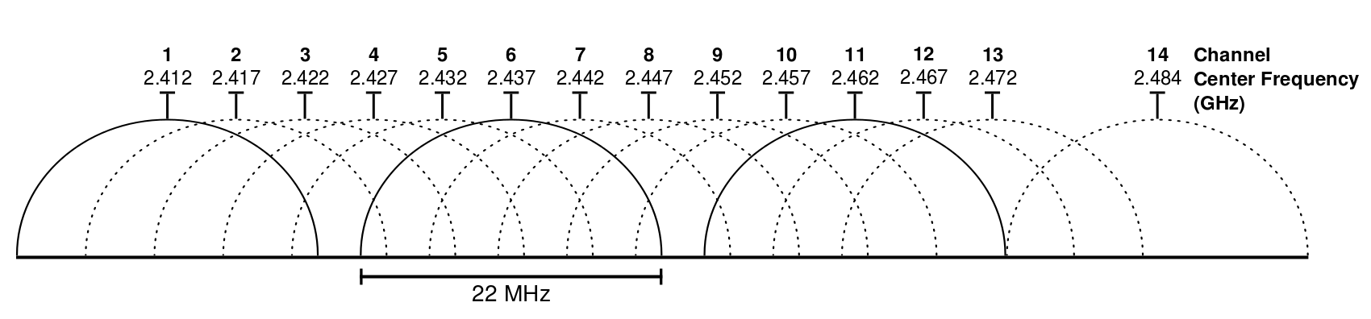


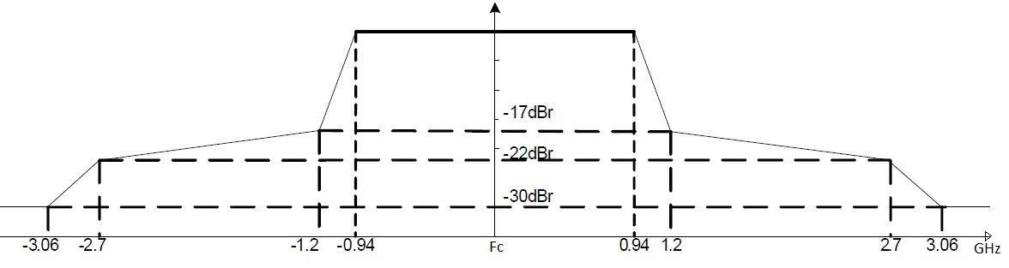
Dynamic Channel Allocation (DCA)
DCA aims to properly allocate the available frequency channels among the overlapping wireless devices. A proper DCA relaxes the SR problem.
Industrial, Scientific and Medical (ISM) band
Smart channel allocation helps at reducing the interference
The number of parallel transmissions is notably increased
Shared by many technologies (802.11, 802.15, U-LTE…)
2.4 and 5 GHz bands
Overlapping channels with co-channel interference
AP 1
AP 1
STA 1
STA 1
AP 2
AP 2
STA 2
STA 2
STA 3
STA 3
AP 3
AP 3
Channel 1
Channel 2
Channel 3

Slide 31
Previous Work in DCA
Coordinated
Graph Colouring [1, 2, 3, 4]
Priority-based [5]
Coverage-oriented [6]
Measurement-based [7]
Dynamic Channel Access
Weighted colouring [8]
MinMax approach [9, 10, 11]
Least congested channel search [12]
Uncoordinated

Slide 32
Appendix B: Ongoing Work

Slide 33
Ongoing work
WNs Through Learning
IEEE 802.11ax Simulator
Self-Managed Networks
Work done
Event-based
Built on top of COST [16]
Oriented to intelligent agents
Open source: https://github.com/wn-upf/Komondor
Version 1 launched
Project 1: AP selection based on a set of parameters
Project 2: AP knowledge base
Project 3: handover through inter-AP communication
Conference paper [13] accepted for presentation in PIMRC
Journal article [14] prepared for future submission
Expected collaboration with Barrachina [15]
Extension of [13, 14] under development
Collaboration agreement achieved with Universidad Autónoma Nacional de México (UNAM)
Under development
Notes:
Mencionar projectes

Slide 34
Appendix C: Analytical Models & Simulation Tools

Slide 35
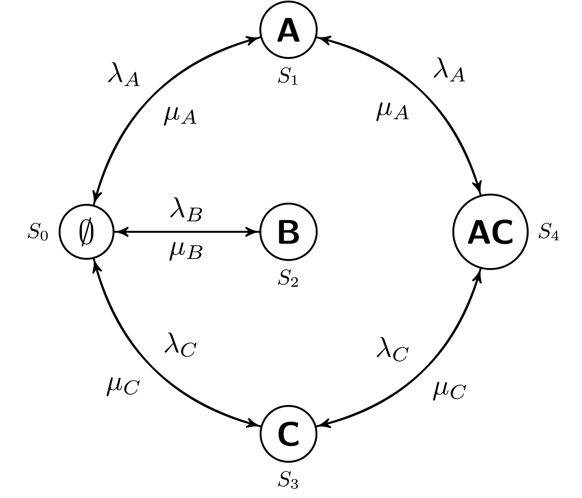
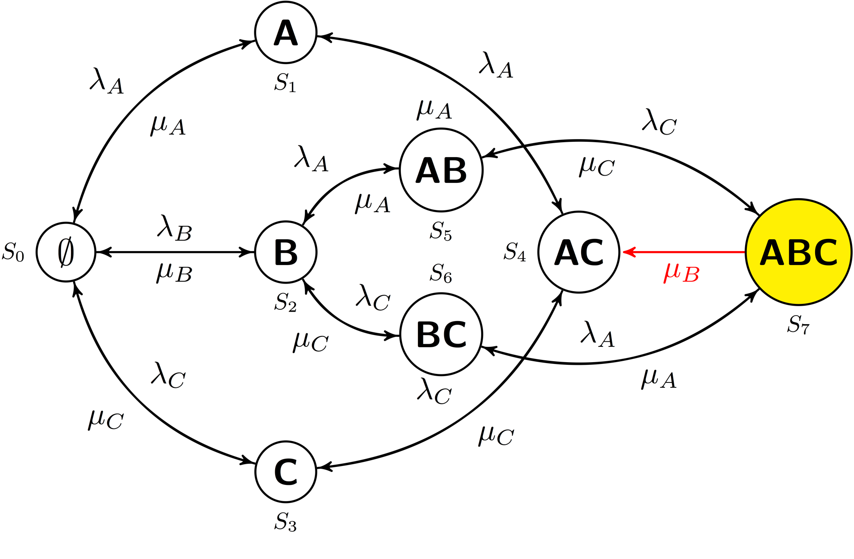
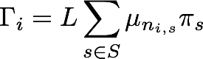
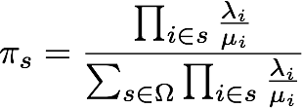
Analytical Models
Continous Time Markov Networks [17]
Bianchi’s model [18]
Direct interference
Additive interference

Slide 36
Simulators
[19, 20, 21, 22]

Slide 37
Appendix References (I)
[1] Hills, A. (2001). Large-scale wireless LAN design. IEEE Communications Magazine, 39(11), 98-107.
[2] Mahonen, P., Riihijarvi, J., & Petrova, M. (2004, September). Automatic channel allocation for small wireless local area networks using graph colouring algorithm approach. In Personal, Indoor and Mobile Radio Communications, 2004. PIMRC 2004. 15th IEEE International Symposium on (Vol. 1, pp. 536-539). IEEE.
[3] Riihijarvi, J., Petrova, M., & Mahonen, P. (2005, January). Frequency allocation for WLANs using graph colouring techniques. In Wireless On-demand Network Systems and Services, 2005. WONS 2005. Second Annual Conference on (pp. 216-222). IEEE.
[4] Riihijarvi, J., Petrova, M., Mahonen, P., & Barbosa, J. D. A. (2006, September). Performance evaluation of automatic channel assignment mechanism for IEEE 802.11 based on graph colouring. In Personal, Indoor and Mobile Radio Communications, 2006 IEEE 17th International Symposium on (pp. 1-5). IEEE.
[5] Wertz, P., Sauter, M., Landstorfer, F. A., Wolfle, G., & Hoppe, R. (2004, September). Automatic optimization algorithms for the planning of wireless local area networks. In Vehicular Technology Conference, 2004. VTC2004-Fall. 2004 IEEE 60th (Vol. 4, pp. 3010-3014). IEEE.
[6] Eisenblatter, A., Geerdes, H. F., & Siomina, I. (2007, June). Integrated access point placement and channel assignment for wireless LANs in an indoor office environment. In World of Wireless, Mobile and Multimedia Networks, 2007. WoWMoM 2007. IEEE International Symposium on a (pp. 1-10). IEEE.[76]
[7] Chen, J. K., De Veciana, G., & Rappaport, T. S. (2007, November). Improved measurement-based frequency allocation algorithms for wireless networks. In Global Telecommunications Conference, 2007. GLOBECOM'07. IEEE (pp. 4790-4795). IEEE.
[8] Mishra, A., Banerjee, S., & Arbaugh, W. (2005). Weighted coloring based channel assignment for WLANs. ACM SIGMOBILE Mobile Computing and Communications Review, 9(3), 19-31.
[9] Leung, K. K., & Kim, B. J. (2003, October). Frequency assignment for IEEE 802.11 wireless networks. In Vehicular Technology Conference, 2003. VTC 2003-Fall. 2003 IEEE 58th (Vol. 3, pp. 1422-1426). IEEE.
[10] Yu, M., Luo, H., & Leung, K. K. (2006). A dynamic radio resource management technique for multiple APs in WLANs. IEEE Transactions on Wireless Communications, 5(7), 1910-1919.
[11] Yu, M., & Luo, H. (2004, November). An adaptive radio resource management technique for APs in WLANs. In Networks, 2004.(ICON 2004). Proceedings. 12th IEEE International Conference on (Vol. 1, pp. 85-91). IEEE.
[12] Achanta, M. (2004). U.S. Patent Application No. 10/959,446.
[13] Wilhelmi, F., Bellalta, B., Cano, C., & Jonsson, A. (2017). Implications of Decentralized Q-learning Resource Allocation in Wireless Networks. arXiv preprint arXiv:1705.10508.
[14] Wilhelmi, F., Bellalta, B., Cano, C., Jonsson, A., Neu, G. & Barrachina, S. (2017). Enhancing Spatial Reuse in Wireless Networks through Decentralised Multi-Armed Bandits: Possibilities, Challenges and Perils.

Slide 38
Appendix References (II)
[15] Barrachina, Sergio, Bellalta, Boris and Wilhelmi, Francesc (2017). Dynamic Spectrum Access in High-density WLANs.
[16] Chen, G., Branch, J., Pflug, M., Zhu, L., & Szymanski, B. (2005). SENSE: a wireless sensor network simulator. Advances in pervasive computing and networking, 249-267.
[17] Bellalta, Boris, et al. "Throughput analysis in CSMA/CA networks using continuous time Markov networks: a tutorial." Wireless Networking for Moving Objects. Springer International Publishing, 2014. 115-133.
[18] Bianchi, Giuseppe. "Performance analysis of the IEEE 802.11 distributed coordination function." IEEE Journal on selected areas in communications 18.3 (2000): 535-547.
[19] NS-3: Network simulator 3 (2010). Carneiro, Gustavo, UTM Lab Meeting April.
[20] Issariyakul, Teerawat, and Ekram Hossain. Introduction to network simulator NS2. Springer Science & Business Media, 2011.
[21] Opnet technologies inc (2009). Modeler, OPNET.
[22] Varga, András, and Rudolf Hornig. "An overview of the OMNeT++ simulation environment." Proceedings of the 1st international conference on Simulation tools and techniques for communications, networks and systems & workshops. ICST (Institute for Computer Sciences, Social-Informatics and Telecommunications Engineering), 2008.

